Slide 1
Door UNLOCK USING FACE MASK DETECTION / smart door
TEAM MEMBERS
O. Srinath Reddy - 18mis1045
K. Diwakar Reddy - 18mis1051
Kotha Sai - 18mis1068
J.V.S Tharun Kousik- 18mis1073
Y. Naveen Reddy - 18mis1075

Slide 2
abstract
The system is designed to detect the faces and to determine whether the person wears a face mask or not. Using the above data, we can decide whether the concerned person can be allowed inside public places such as the market, or a hospital. This project can be used in the hospital, market, bus terminals, restaurants, and other public gatherings where the monitoring has to be done.

Slide 3
This project is run through connecting of hardware components and it is interlinked with software part to check whether the person wears mask or not. Face will be captured through Camera and detects whether the person is wearing a face mask or not using their facial features and the data is sent to Arduino and it sends the information for motor to open the door or not.

Slide 4
introduction
Objective and goal :
The principle objective of “Smart Door” project is to give some effective innovation to prevent the spread of Corona virus. Primary objectives behind the improvement of this project are as per the following:
-Preventing the spread of Corona virus by advancing the utilization of face masks assistance of advance technology to identify the face mask.
Ensure a protected workplace.
Save the lives of people

Slide 5
Problem Statement
To Design a system to determine whether the person wearing a face mask or not. Using the data, which we get from the camera we can decide whether the concerned person can be allowed inside the place or not. This project can be used in the hospital, market, bus terminals, restaurants, and other public places where the monitoring has to be done.

Slide 6
MOTIVATION
The motivation of our project is to make a system that helps the people to allow the inside the house or any public places like banks, hospitals, airports etc, only if they are covered their face with the mask or else the person is not allowed which helps the people from the spread of Corona virus .

Slide 7
Requirement Specification
SOFTWARE REQUIREMENTS
HARDWARE REQUIREMENTS
Operating Environment
Operating System: Windows 7 or later
Processor: Intel i3 or higher
Memory: 4gb or more
Dependencies:
Python
TensorFlow - Keras
OpenCV
Camera (Webcam is enough)
Arduino Uno
Connecting Wires
Servo Motor And
A Door

Slide 8
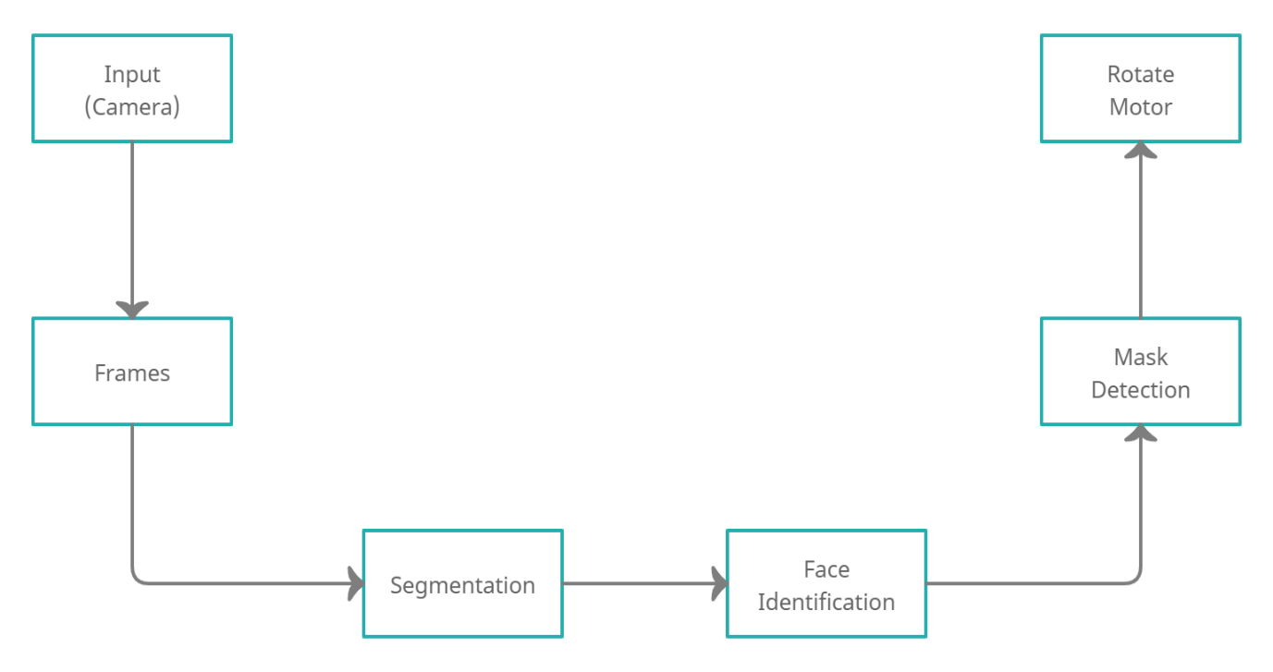
System DESIGN

Slide 9
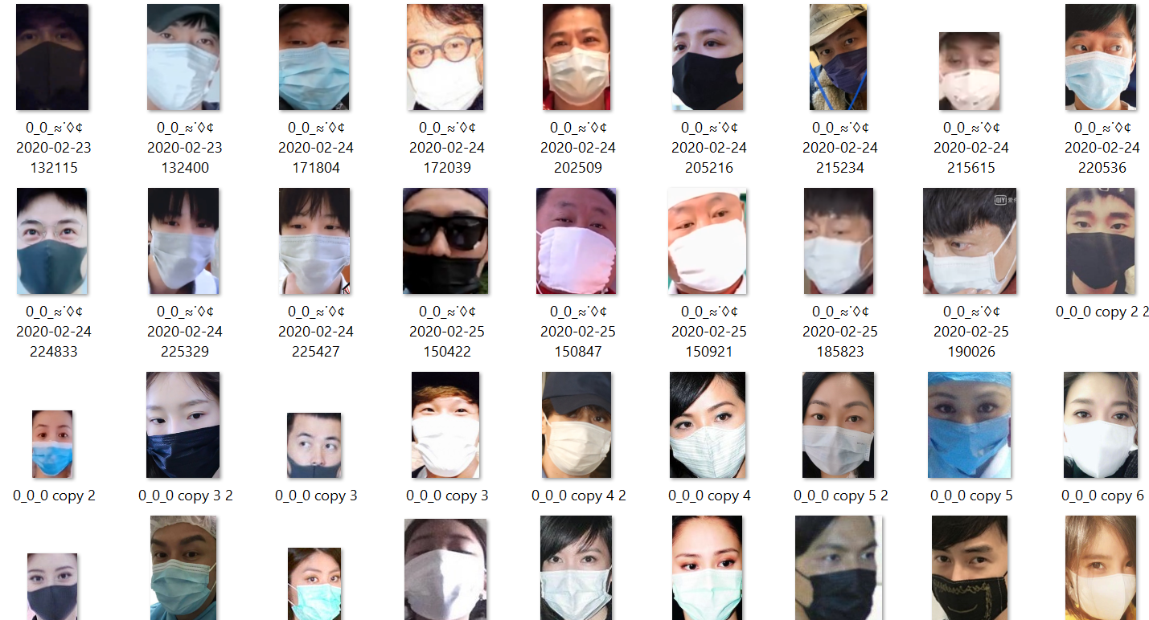
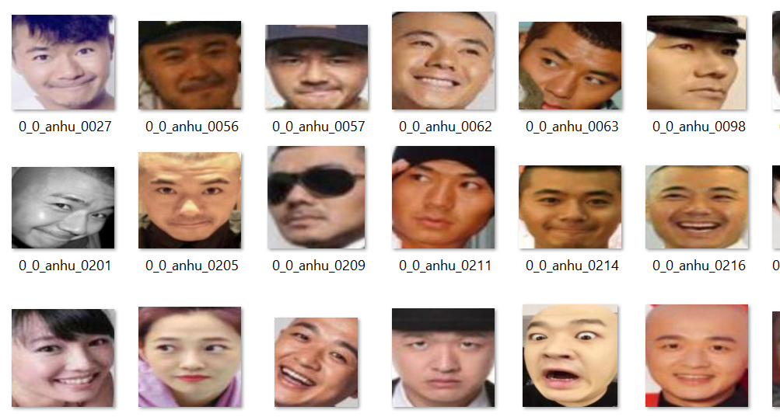
Data set
With Mask
WITHOUT MASK

Slide 10
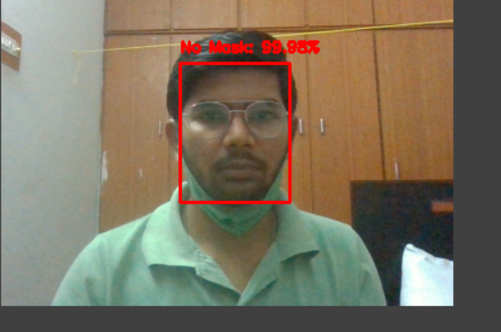
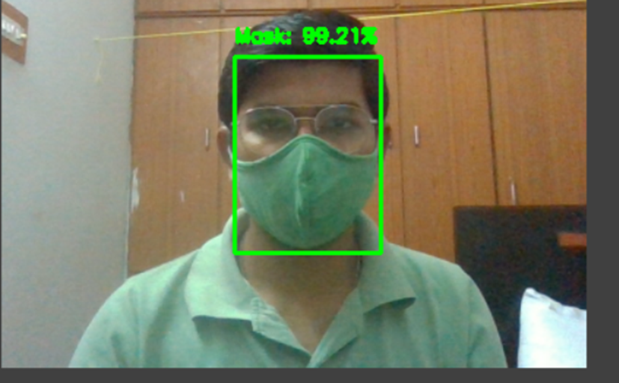
OUTPUTS

Slide 11
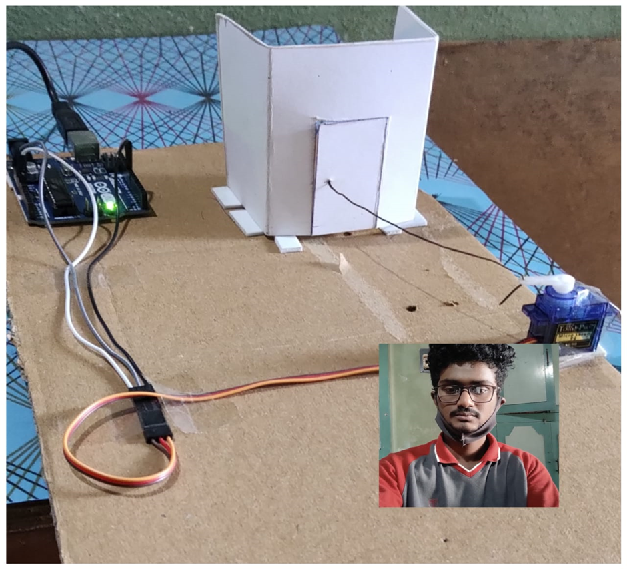
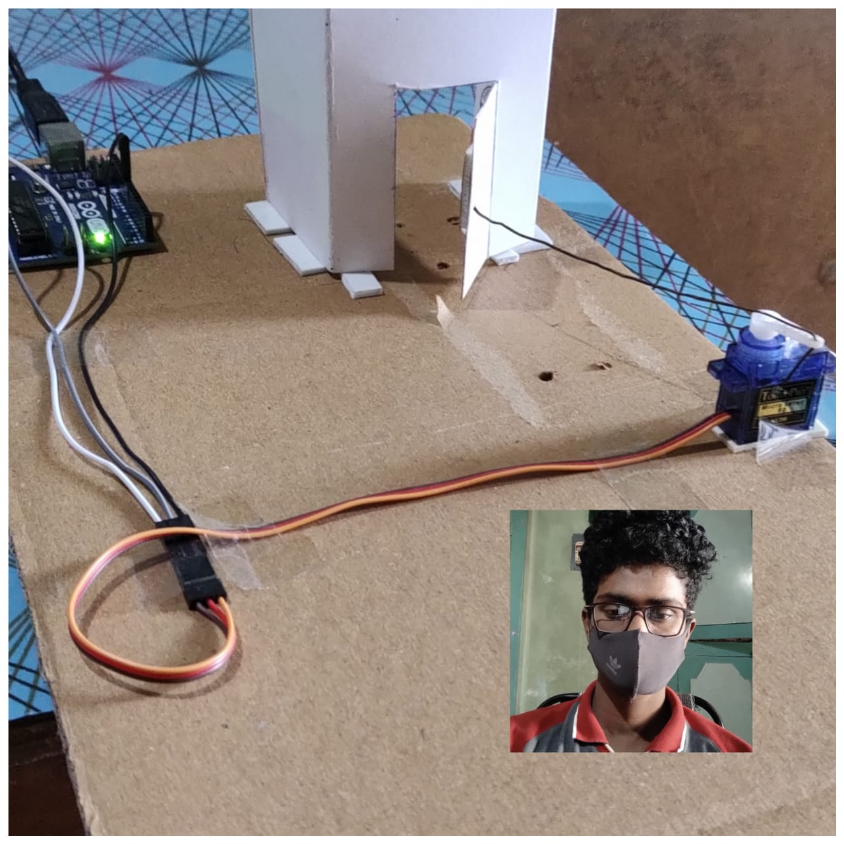

Slide 12
REferences
https://www.researchgate.net/publication/345972030_A_FACEMASK_DETECTOR_USING_MACHINE_LEARNING_AND_IMAGE_PROCESSING_TECHNIQUES
https://www.sciencedirect.com/science/article/pii/S2666285X21000996
https://ieeexplore.ieee.org/document/9342585

